Slide 1
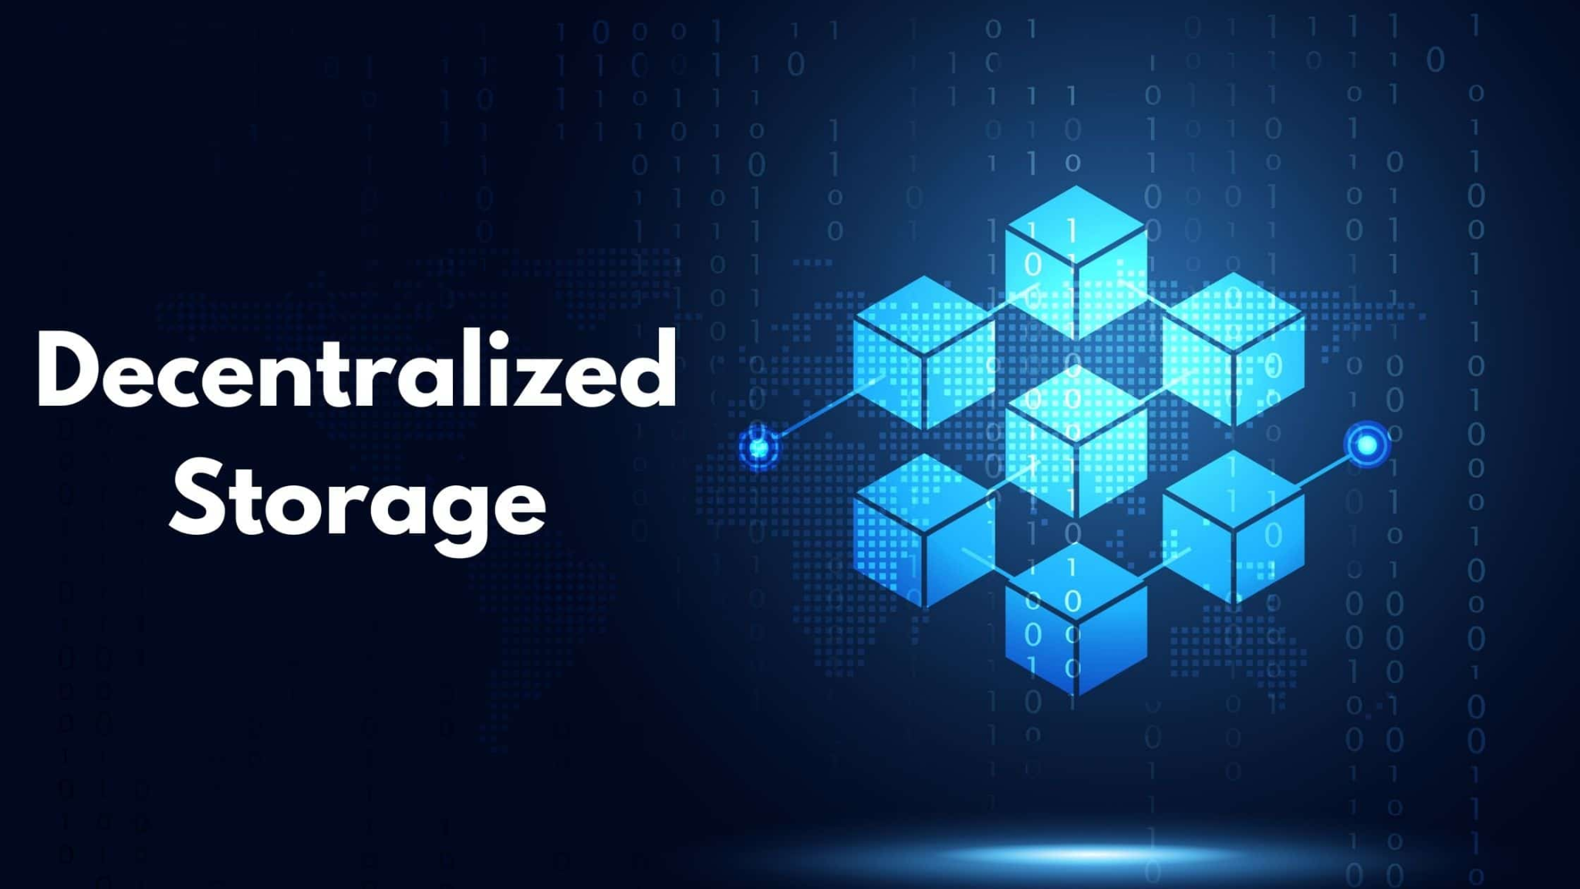
BLOCK - DRIVE
A DECENTRALISED STORAGE SYSTEM

Slide 2

Done By :
M. George Steven
A. Prudhvi Raj
R. Hasitha Sree
P. Sai Krishnam Raju
Under the guidance of Dr. Sudheer Kumar Bathula

Slide 3
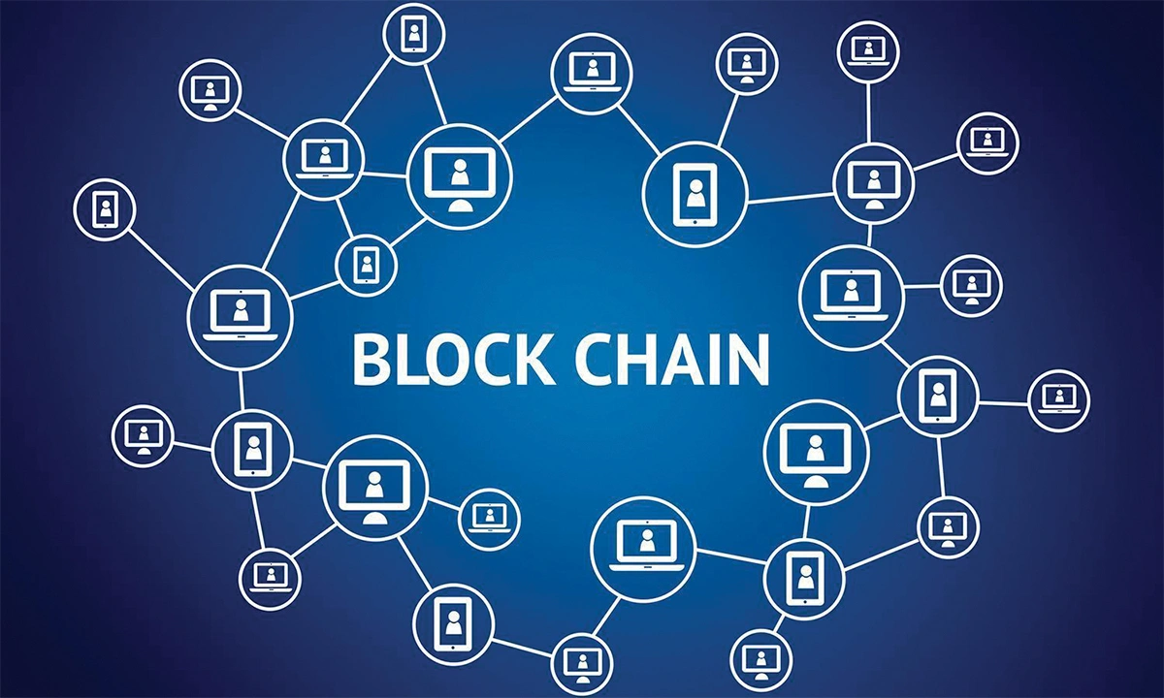

BLOCKCHAIN AND BITCOIN
What is a Blockchain?
It is a system of recording information in a
way that makes it difficult or impossible to
change, hack, or cheat the system.
It is a decentralised digital ledger that is
used for recording transactions.
What is a Bitcoin?
Bitcoin is a digital currency which operates
free of any central control or the oversight
of banks or governments.
Bitcoin is a popular cryptocurrency that
operates on blockchain technology and is
immutable.

Slide 4
Purpose and Thought
The Blockchain is currently limited to store only transactions and records of transactions.
We thought about this transaction thing and we got a thought about why can we not store files and documents in blockchain?
So we thought of extending this project to store other file formats like .jpg and .mp4 etc.

Slide 5
PROBLEM STATEMENT
In the present days, current cloud storages like Google Drive, One Drive, iCloud etc offer a valuable storage spaces to their customers but they lack one main feature : Security and trust.
In order to achieve the individual file security, we designed this decentralised storage system called
Block - Drive to secure the individual files.
There are some existing technologies regarding decentralised applications for storage and we are proposing a better idea that reaches every user.

Slide 6
AIM OF THE PROJECT
We aim to build a decentralised storage system using ethereum blockchain and IPFS.
Due to the existing apps using third party applications, they lack security, trust and immutability.
This works on technologies like Ethereum DAPP, Truffle and front end technologies like Bootstrap 3.
We eliminate these security concerns in this project using these technologies.

Slide 7
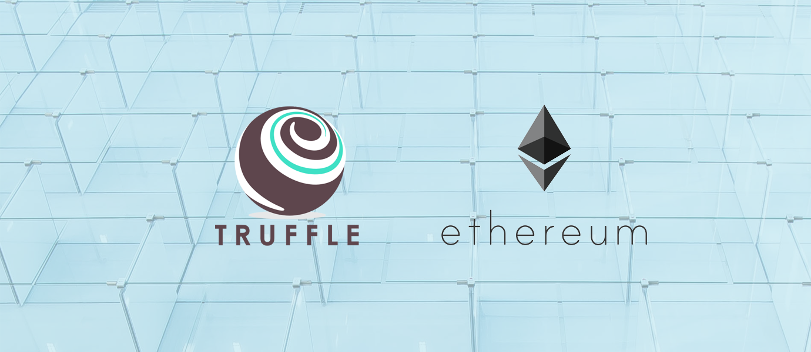
Technologies Used
IPFS (Inter - Planetary File System)
Ethereum DAPP
Truffle
Framework : Web3
Node.js

Slide 8
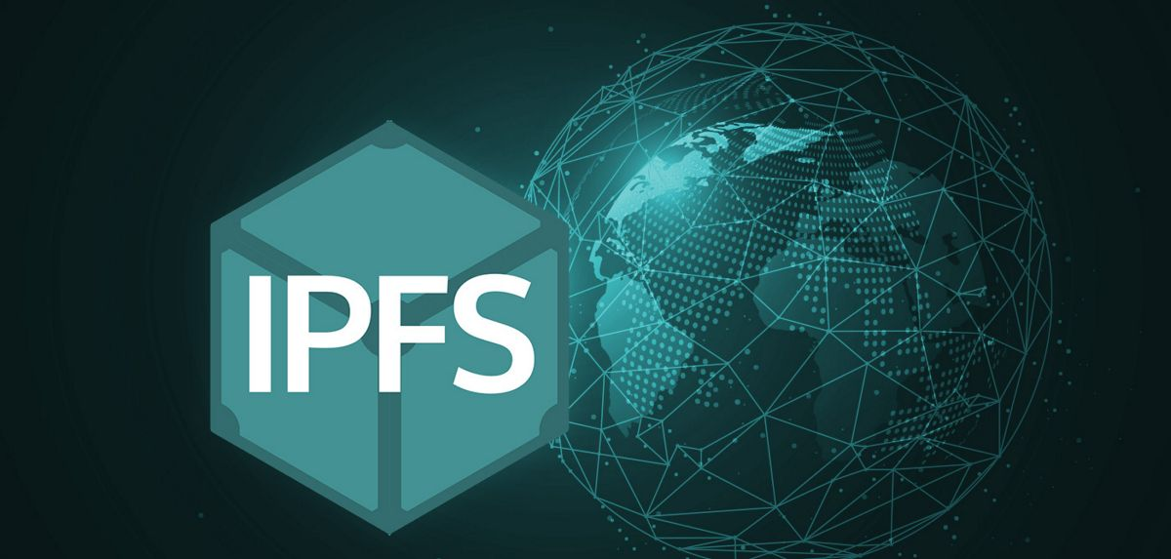
Interplanetary File System (IPFS)
IPFS is a distributed system for storing and accessing files, websites, applications, and data.
It’s a peer-to-peer (p2p) file sharing system that aims to change the way information is distributed across & beyond the globe.
IPFS allows users to host and receive content in a way similar to BitTorrent.

Slide 9
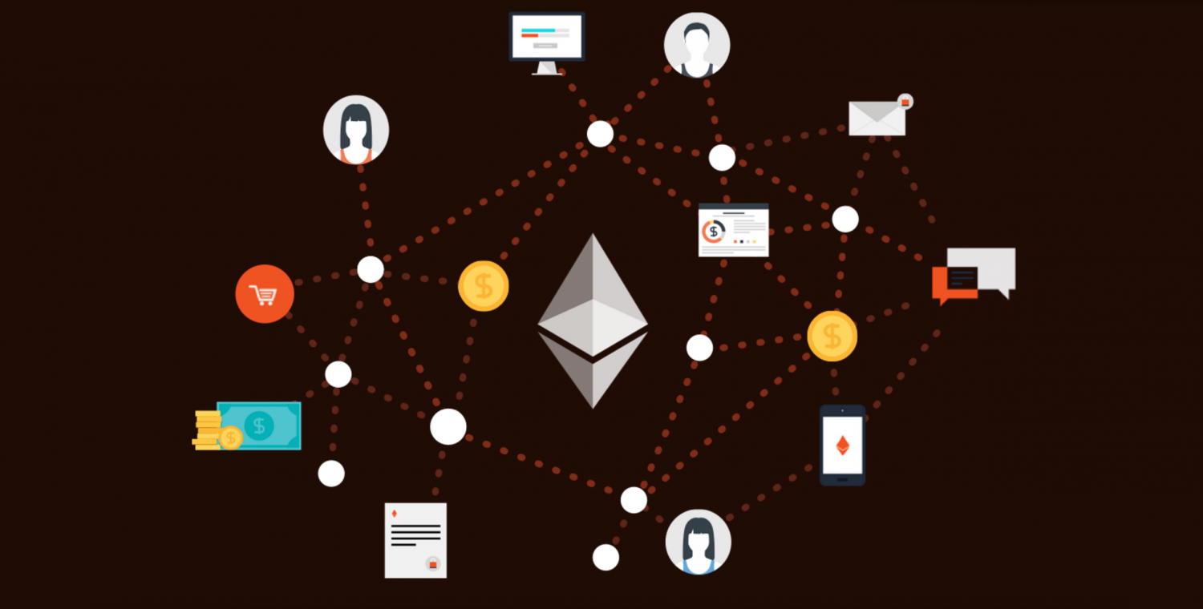
ETHEREUM DAPP
This is a decentralized application that is powered and developed using the Ethereum platform.
Ethereum DApps use smart contracts for their working.
We developed and deployed it on the Ethereum network and used the platform's blockchain for data storage.
Ethereum enables the smart contracts and applications built on its blockchain to run smoothly without fraud, downtime, control, or any third-party interference.

Slide 10
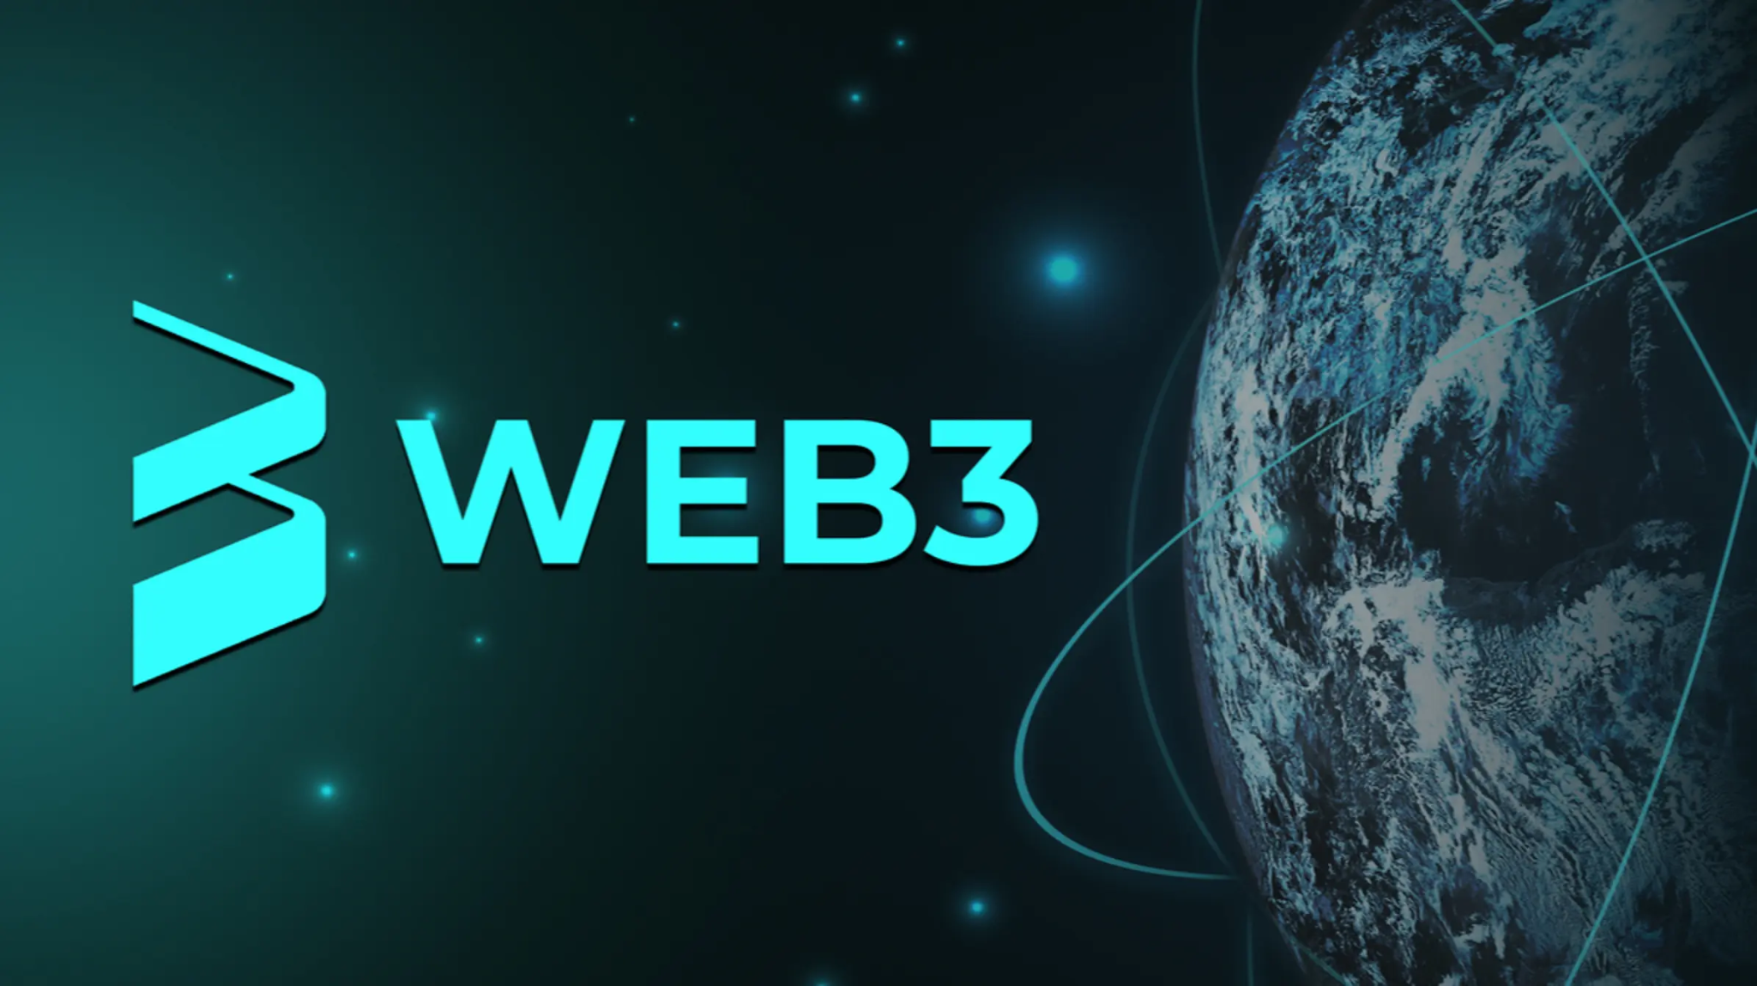
WEB 3
Web 3.0 is the 3rd gen of the internet where websites and apps will be able to process information in a smart way through technologies ML, Big Data, decentralized ledger technology (DLT), etc.
Web3 is an idea for a new iteration of the World Wide Web based on blockchain, which incorporates concepts such as decentralization.

Slide 11
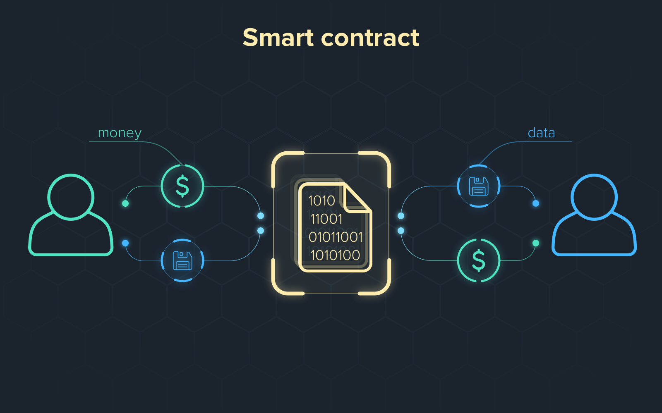
Smart Contracts
Smart contracts are programs that are stored on a blockchain that run when some predefined conditions are met.
Smart contracts allow trusted transactions and agreements to be carried out between anonymous parties without the need for a central authority.

Slide 12
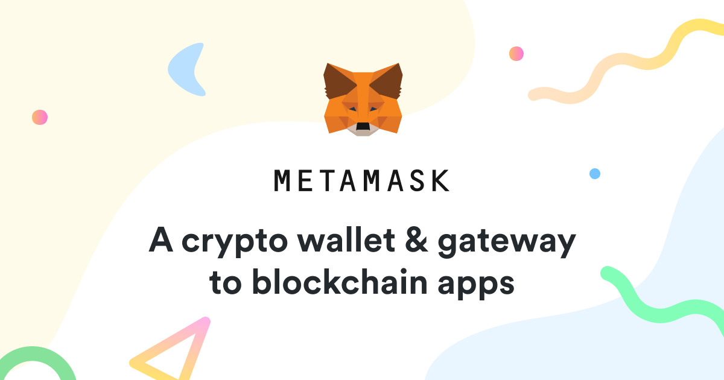
METAMASK
MetaMask is a software cryptocurrency wallet that is used to interact with the Ethereum blockchain.
It allows users to store and manage account keys, send and receive Ethereum-based cryptocurrencies and tokens, and securely connect to decentralized applications through a web browser.
Using MetaMask we are going to establish a connection using Web3.js between Ethereum DApp and Ganache network.

Slide 13
Mechanism
We have 5 steps in the mechanism:
We create a dynamic webpage to upload a file in the IPFs and we create an event to upload the file to the IPFS and then returning a hash.
By using infura network, we initialise the IPFS manually for sending the file into the IPFS and returning the hash.
We create an ethereum network to store the hash of the file by using smart contracts (GET & SET).
SET will send the hash into the blockchain network and GET will return the hash from the blockchain network.
We connect the smart contract in the front end and we create a decentralised website to store in the blockchain.

Slide 14
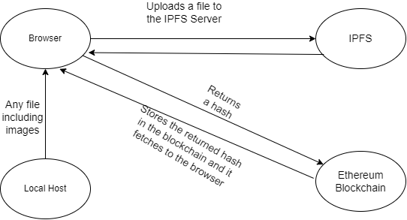

Slide 15
Deploying the Smart Contract
In order to deploy a smart contract, we need to have a Web3.js with our localhost through MetaMask we can connect to the blockchain.
So accordingly when a user uploads a file and clicks the submit button, he gets a notification from the MetaMask to confirm the transaction to go into the Ganache server.

Slide 16
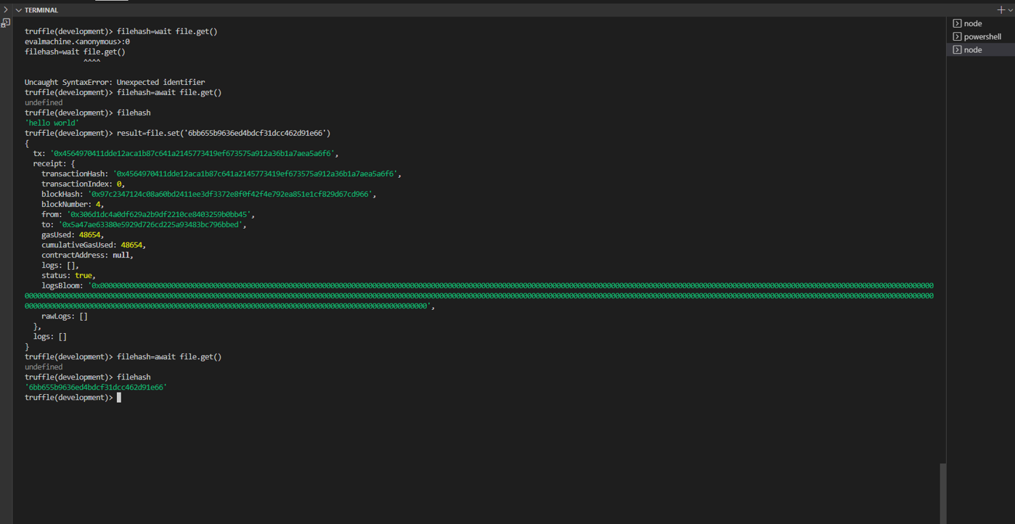
OUTPUTS

Slide 17
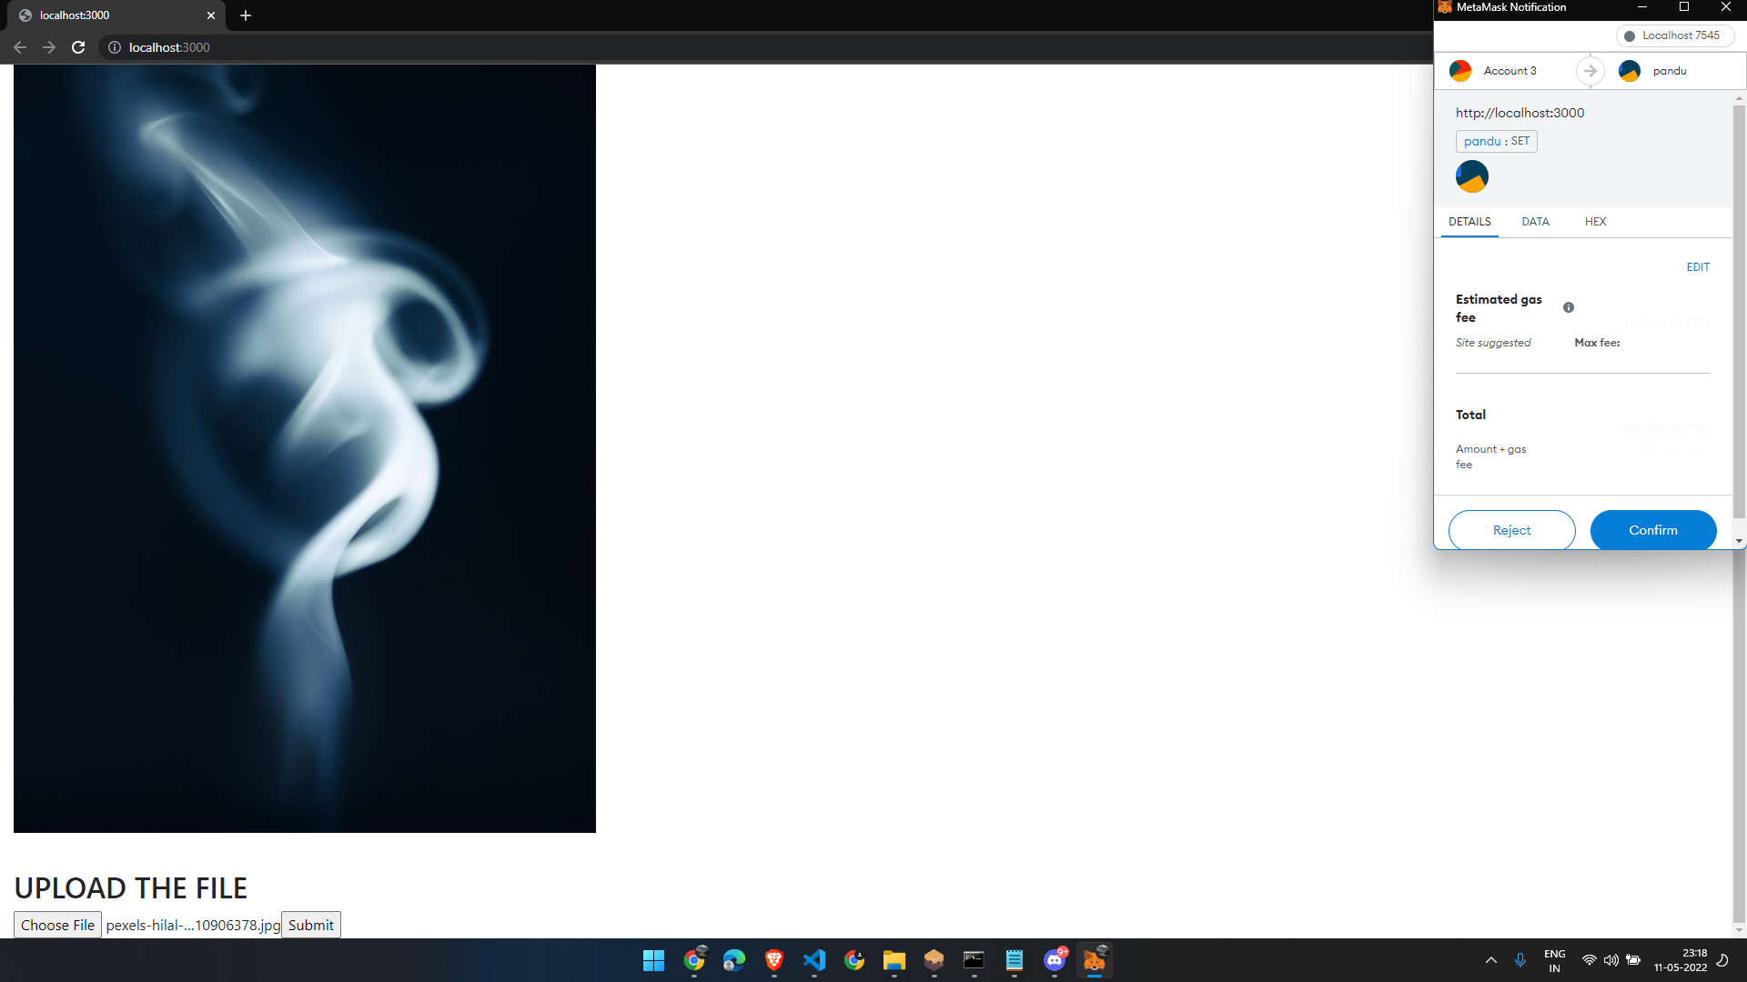

Slide 18
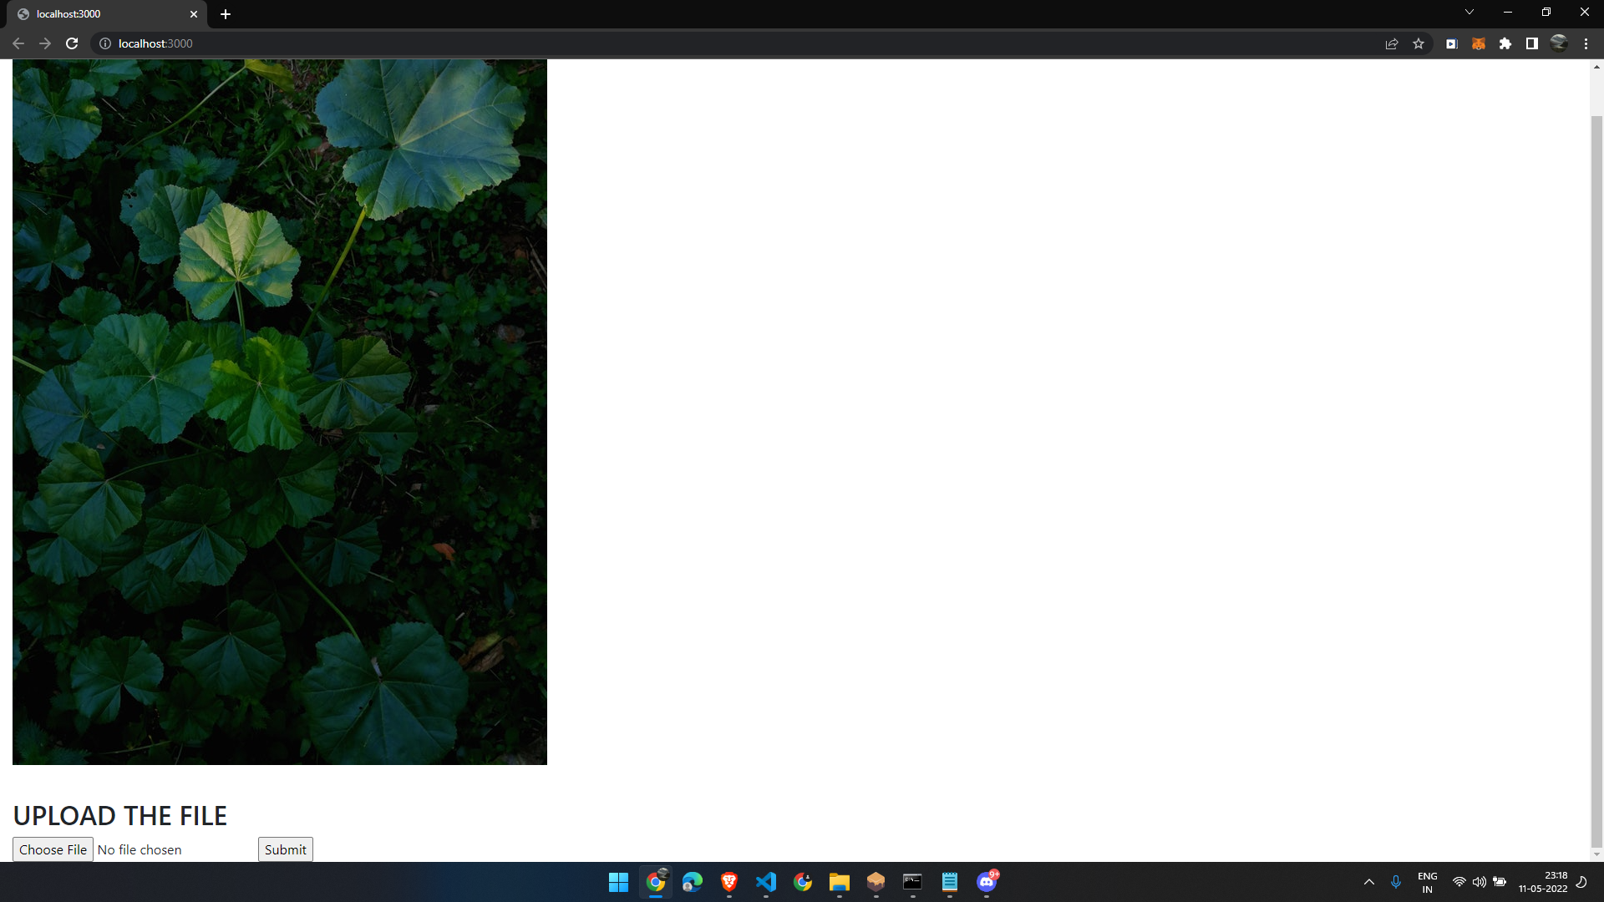

Slide 19
CONCLUSION
The file was successfully uploaded to the IPFS and fetched the hash to the ethereum blockchain.
In coming days, we are going to privatise the blockchain and make the user comfortable to upload his personal files into the Block-Drive.

